Slide 1
Fisherfaces Vs Eigenfaces
Anwesh Mohanty : 170070009
Rohan Bansal : 170070058
Shivanshu Gupta : 170020032

Slide 2
Eigenfaces (based on PCA)
Many features of the human face are heavily correlated and therefore provide only redundant information.
PCA acts as a dimensionality reduction algorithm by creating a new space of features which can provide the maximum discrimination amongst images.
It does so by projecting data points along the axis of the maximum variation (PC1), followed by the second maximum variation axis (PC2) and so on.
Only the top k-axes are chosen keeping in mind the accuracy required and resource constraints.

Slide 3


Mathematics behind PCA
Transformation matrix W is given by :
Covariance matrix is given by :

Slide 4
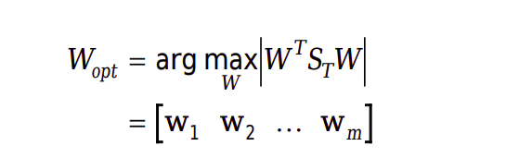
We need to choose the transformation matrix so as to maximize the variance , which is given by :
Each column of the transformation matrix turns out to be an eigenvector of the total scatter matrix

Slide 5
Drawbacks of Eigenfaces
We work with the total scatter matrix in this case. This contains the between class scatter (useful for classification) but also the within class scatter (unwanted information).
Much of variation from one image to next is due to illumination changes.
As a result, variation in lighting/shadowing creeps into the outcome if only eigenfaces are used.

Slide 6
Linear Discriminant Analysis
LDA algorithm aims to maximize separability between classes and minimize variance within classes
Leads to the concept of within class and between class scatter matrix
LDA does this by maximizing the ratio of the determinant of between class scatter matrix to that of the within class scatter matrix

Slide 7
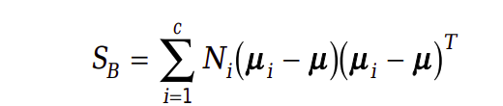

Mathematics behind LDA
Between class scatter matrix is given by:
Within class scatter matrix is given by:

Slide 8


Therefore transformation matrix is given by:
This reduces into solving the following problem:

Slide 9
Generally Sw matrix (n x n) tends to be singular as the rank is at most N-c because of the dimension of an image being much larger than the number of test images.
In this case PCA is used for dimensionality reduction
It throws away the least useful c-1 principal components
Then LDA is applied to further reduce dimensionality to c-1.

Slide 10
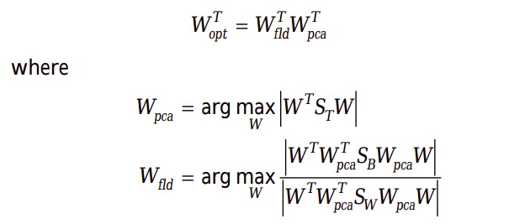
The new equation is given by:

Slide 11
Therefore PCA smears out class differences while LDA retains it .
PCA maximizes overall scatter while LDA maximizes between class scatter for better classification

Slide 12
Implementation
Dataset
We have used a dataset with 10 classes (persons) each having 64 images
Within each class the subject is placed under different lighting/shadowing conditions
Hence this dataset is ideal to show difference between eigenfaces and fisherfaces

Slide 13












Example Faces in Dataset

Slide 14
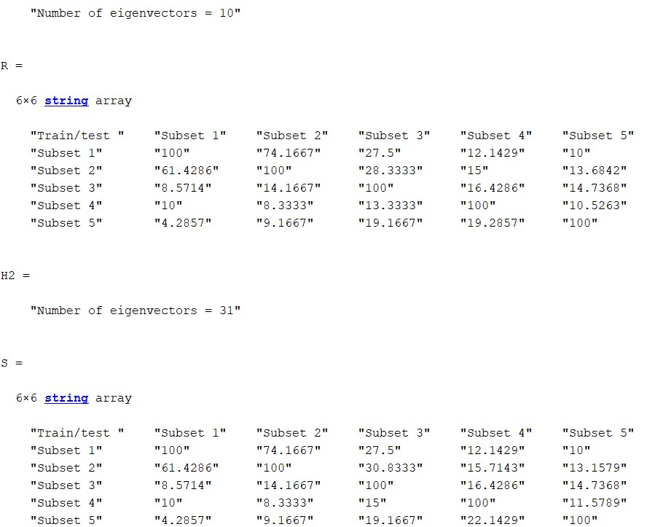
Accuracy Comparison
Using Eigen Faces

Slide 15
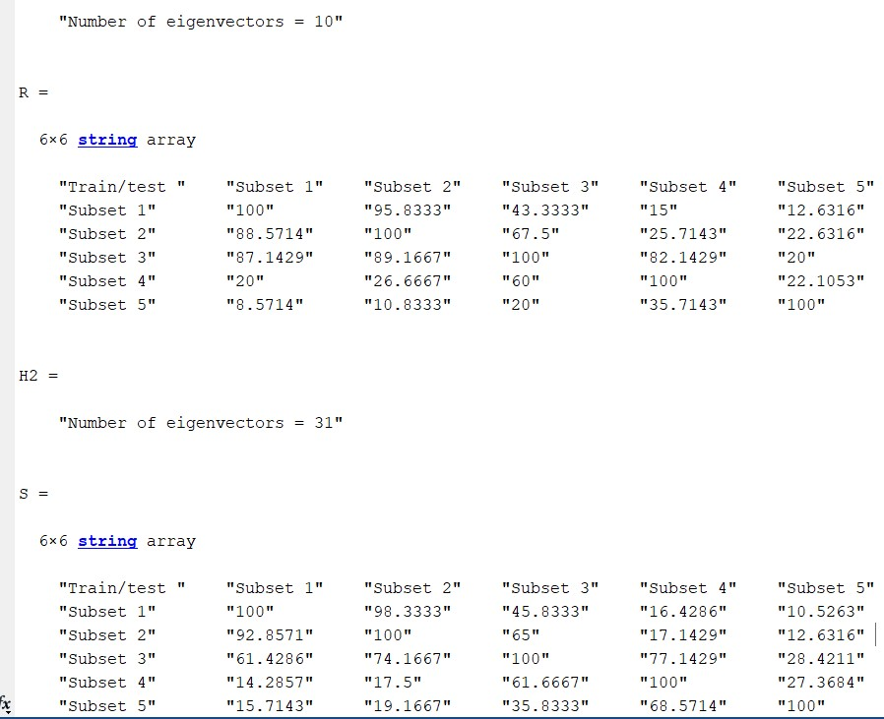
Accuracy Comparison
Using Fisher Faces

Slide 16
References
https://cseweb.ucsd.edu/classes/wi14/cse152-a/fisherface-pami97.pdf
https://iopscience.iop.org/article/10.1088/1742-6596/1028/1/012119/pdf

